Slide 1
NICE LAYOUT
HOW THIS WORKS
STEP 1→ STEP 2→ STEP 3
(ACTIONS PANEL)
STEP 1→ STEP 2→ STEP 3
MY WISHLIST
cards
I WANT TO COMPARE…
checkboxes
CLICK CARD TO COMPARE
cards
COMPARISON TABLE (try to squeeze everything in)
(VERTICAL SCROLLING, PPL DON’T LIKE HORIZONTAL…)
cards

Slide 2
Technical Info + Customized Card Comparison
Based on DBS cards

Slide 3
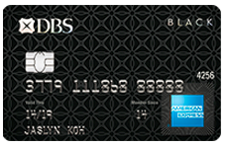
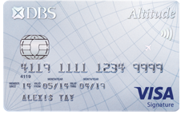
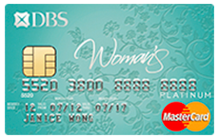
HOW TO USE:
Tick on the criterias that you wish to compare. Click on Information button to understand more
i
DIY CARD COMPARER
SELECT ALL
CLEAR SELECTION
RESET ALL
RECOMMENDED FOR YOU
Card Type | DBS Points | Dining | Healthcare
American Express | 1X DBS Point on all transactions | DBS Indulge Dining deals at over 1000 outlets islandwide American Express Selects Over 400 dining privileges islandwide | DBS Healthcare Privileges Special rates on health screening packages, specialist consultation fee and more.
Visa | No expiry date for DBS Rewards Points | DBS Indulge Dining deals at over 1000 outlets islandwide | DBS Healthcare Privileges Special rates on health screening packages, specialist consultation fee and more.
MasterCard | Earn 5X DBS Rewards Points on all online purchases | DBS Indulge Dining deals at over 1000 outlets islandwide | DBS Healthcare Privileges Special rates on health screening packages, specialist consultation fee and more.
Card Type
i
Annual Fee Waiver
i
Min Income(per annum)
i
DBS Black American Express® Card
Card Rewards & Benefits
  DBS Points
  Rebate/Cashback
  Miles
i
DBS Altitude Visa Signature Card
Lifestyle Privilege
  Transport
  Dining
  Movies
  Travel
  Healthcare
i
DBS Woman's MasterCard® Card
i
RANK FOR ME

Slide 4
Added Features Template
Preset Criterias from Questionnaire (Dining, Healthcare, Movies)
Click to add from whole range of credit cards- not only recommended ones. Scrollable area
combine with yujia! IMPLEMENT HOW button directly?

Slide 5
FINALIZE THIS FIRST BEFORE MAKING TRANSITIONS
HOW TO USE:
Tick on the criterias that you wish to compare. Click on Information button to understand more
DIY CARD COMPARER
RESET ALL
i
CLICK ON ANY CARDS BELOW TO COMPARE:
Card Type | DBS Points | Dining | Movies | Healthcare
American Express | 1X DBS Point on all transactions | DBS Indulge Dining deals at over 1000 outlets islandwide American Express Selects Over 400 dining privileges islandwide |  | DBS Healthcare Privileges Special rates on health screening packages, specialist consultation fee and more.
Visa | No expiry date for DBS Rewards Points | DBS Indulge Dining deals at over 1000 outlets islandwide |  | DBS Healthcare Privileges Special rates on health screening packages, specialist consultation fee and more.
MasterCard | Earn 5X DBS Rewards Points on all online purchases | DBS Indulge Dining deals at over 1000 outlets islandwide |  | DBS Healthcare Privileges Special rates on health screening packages, specialist consultation fee and more.
SELECT ALL
CLEAR SELECTION
Recommended: DBS Black American Express® Card
Card Type
i
Remove
Recommended: DBS Altitude Visa Signature Card
Annual Fee Waiver
i
Min Income(per annum)
i
Recommended: DBS Woman's MasterCard® Card
Card Rewards & Benefits
  DBS Points
  Rebate/Cashback
  Miles
i
RANK FOR ME
i
You are also eligible for:
grey out selected cards so users know they have been selected
CLICK ON A CARD TO COMPARE
Lifestyle Privilege
  Transport
  Dining
  Movies
  Travel
  Healthcare
i

Slide 6
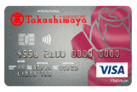
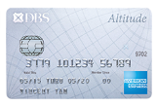
FINALIZE THIS FIRST BEFORE MAKING TRANSITIONS
HOW TO USE:
Tick on the criterias that you wish to compare. Click on Information button to understand more
CLICK ON ANY CARDS BELOW TO COMPARE:
?
DIY CARD COMPARER
RESET
CURRENTLY COMPARING:
Undo
Redo
RESET
Dining | Movies | Healthcare
DBS Indulge Dining deals at over 1000 outlets islandwide American Express Selects Over 400 dining privileges islandwide |  | DBS Healthcare Privileges Special rates on health screening packages, specialist consultation fee and more. | Compare more criterias by clicking any one on the left
DBS Indulge Dining deals at over 1000 outlets islandwide |  | DBS Healthcare Privileges Special rates on health screening packages, specialist consultation fee and more.
DBS Indulge Dining deals at over 1000 outlets islandwide |  | DBS Healthcare Privileges Special rates on health screening packages, specialist consultation fee and more.
SELECT ALL
CLEAR SELECTION
Card Type
?
Recommended: DBS Black American Express® Card
Annual Fee Waiver
?
Min Income(per annum)
Remove
Recommended: DBS Altitude Visa Signature Card
?
Card Rewards & Benefits
  DBS Points
  Rebate/Cashback
  Miles
?
Recommended: DBS Woman's MasterCard® Card
WE RECOMMEND:
Lifestyle Privilege
  Transport
  Dining
  Movies
  Travel
  Healthcare
?
RANK FOR ME
i
You are also eligible for:
grey out selected cards so users know they have been selected
CLICK ON A CARD TO COMPARE
Similar users also applied for:
CLICK ON A CARD TO COMPARE
DBS Altitude American Express ® Card
DBS Takashimaya Visa Card

Slide 7
Sequence of Transitions to show (ENSURE ALL BUTTONS GOT DEMO)
Transition | Buttons Involved | Demonstration Sequence
User goes from recommendations page to DIY Card Comparer Tool | Compare Cards Back to Recommendations | Recommended Page(Compare or Apply) → Card comparer w preset criterias ; Recommended Cards are greyed out by default since we haven added them into “Currently Comparing” BACK → Compare Cards Again
User explores a term to understand laymen definition, and clicks a link to understand more in detail | Question Mark Button Got it! in pop-up dialog HOW? button | Click on ? Button about DBS Points→ HOW IT WORKS(Detailed steps page)
User chooses the criteria that they wish to compare | Clickable Criterias Cancel Columns Undo / Redo Add My Interests Select all checkmark | ADD/DELETE CRITERIA: Click on category→ new column appears (according to list order) Cancel button→ column disappears Undo / Redo buttons (Switch between slides for 1 & 2) SELECT ALL CRITERIAS: everything appears CLEAR SELECTION: all columns are removed
User adds/delete cards they wish to compare Have the choice to reset to recommended cards | Remove Card button Clickable Cards CLEAR button (for cards) Heart-shaped like button Select all checkmark | Card Selection: Remove 2 recommended ones (Undo) Browsing(Also eligible, Others also applied for) Sections: Adding 2 (1 each) into “Currently Comparing” (card is greyed out in the list) (ADD BACK AGAIN) Select all recommended Cards(on top of existing 2) [CHECKBOX] LIKE (HEART SHAPE) some cards ON THE RIGHT COLUMN→ Added into “My wishlist”→ (CAN CLICK ON APPLY NOW) CLEAR all cards [clear button ON COMPARING CARDS]
User tries out this default button- | Reset Default Button | After everything is cleared, user clicks reset default to display the original recommendations(cards) and pre-selected criterias based on questionnaire’s interests/focus areas
User wants to rank the cards by category | Rank for me OK | Ranking System displayed & OK button

Slide 8
UI Considerations ☺
Minimize memory Load(users shouldn’t need to look there and here)
Merge similar functions, put them in same area
Neat- easy to reference; eye movements
Immediate feedback
Forgiveness- users can undo/redo, and reset to default(recommended cards and preselected criterias)
OTHER POSSIBLE FEATURES(GOOD TO HAVE):
  user can manually sort the card & criterias order(Colornote)- need coding

Slide 9
FINALIZED UI (NEAT AND SPACIOUS, WEBSITE SIZED)
DO HEURISTIC INSPECTION FIRST BEFORE MAKING TRANSITIONS
https://www.usability.gov/how-to-and-tools/methods/heuristic-evaluation.html
Nielsen’s Heuristics
Though many groups have developed heuristics, one of the best-known sources is the set developed by Nielsen’s in 1994. Nielsen refined the list originally developed in 1990 by himself and Rolf Molich. Nielsen’s Heuristics include:
Visibility of system status: The system should always keep users informed about what is going on, through appropriate feedback within reasonable time.
Match between system and the real world: The system should speak the users' language, with words, phrases and concepts familiar to the user, rather than system-oriented terms. Follow real-world conventions, making information appear in a natural and logical order.
User control and freedom: Users often choose system functions by mistake and will need a clearly marked "emergency exit" to leave the unwanted state without having to go through an extended dialogue. Support undo and redo.
Consistency and standards: Users should not have to wonder whether different words, situations, or actions mean the same thing. Follow platform conventions.
Error prevention: Even better than good error messages is a careful design which prevents a problem from occurring in the first place. Either eliminate error-prone conditions or check for them and present users with a confirmation option before they commit to the action.
Recognition rather than recall: Minimize the user's memory load by making objects, actions, and options visible. The user should not have to remember information from one part of the dialogue to another. Instructions for use of the system should be visible or easily retrievable whenever appropriate.
Flexibility and efficiency of use: Accelerators—unseen by the novice user—may often speed up the interaction for the expert user such that the system can cater to both inexperienced and experienced users. Allow users to tailor frequent actions.
Aesthetic and minimalist design: Dialogues should not contain information which is irrelevant or rarely needed. Every extra unit of information in a dialogue competes with the relevant units of information and diminishes their relative visibility.
Help users recognize, diagnose, and recover from errors: Error messages should be expressed in plain language (no codes), precisely indicate the problem, and constructively suggest a solution.
Help and documentation: Even though it is better if the system can be used without documentation, it may be necessary to provide help and documentation. Any such information should be easy to search, focused on the user's task, list concrete steps to be carried out, and not be too large.

Slide 10
original template
do not edit
duplicate slide to make edits or effects

Slide 11
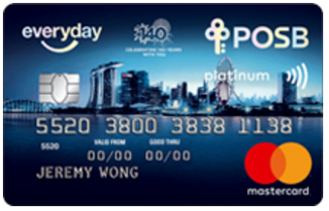
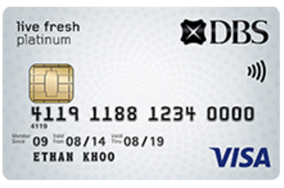
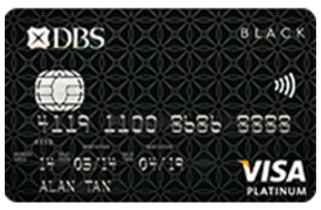
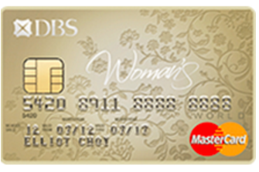
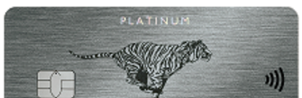
DIY CARD COMPARER
BACK TO RECOMMENDATIONS
?
CLICK ON ANY CARD TO COMPARE:
WHAT DO YOU WISH TO COMPARE?
HOW TO USE:
Click on the criterias that you wish to compare.
Click on the ? button to understand more..
WE RECOMMEND:
You are also eligible for:
Similar users also applied for:
DBS Black American Express® Card
DBS Altitude American Express ® Card
DBS Takashimaya Visa Card
Pop-up dialog, click Got it! to close
Card Type
Undo
Redo
?
NEW!
DBS Altitude Visa Signature Card
POSB Everyday Card
DBS Live Fresh Card
Acceptance Rate
Annual Fee Waiver
?
?
Min Income(per annum)
DBS Black Visa Card
?
Lifestyle Privilege
  Transport
  Dining
  Movies
  Travel
  Healthcare
DBS Woman's MasterCard® Card
DBS Woman's World MasterCard® Card
?
Card Rewards & Benefits
  DBS Points
  Rebate/Cashback
  Miles
?
DBS Esso Card
CURRENTLY COMPARING:
‘Like’ all the cards you wish to apply for
Card | Dining | Travel | Healthcare | CHOOSE ANOTHER CRITERIA BY CLICKING ABOVE
 | DBS Indulge Dining deals at over 1000 outlets islandwide American Express Selects Over 400 dining privileges islandwide | Special airline fares Complimentary hotel nights Up to 15% off car rentals | DBS Healthcare Privileges Special rates on health screening packages, specialist consultation fee and more.
 | DBS Indulge Dining deals at over 1000 outlets islandwide | Exclusive hotel and travel offers. Click here to learn more. | DBS Healthcare Privileges Special rates on health screening packages, specialist consultation fee and more.
 | DBS Indulge Dining deals at over 1000 outlets islandwide | Special airline fares Complimentary hotel nights Up to 15% off car rentals | DBS Healthcare Privileges Special rates on health screening packages, specialist consultation fee and more.
RESET DEFAULT
?
CLEAR
Recommended: DBS Black American Express® Card
RANK FOR ME
?
Remove
I WANT TO APPLY FOR:
<list is updated when user like/unlike>
Recommended: DBS Altitude Visa Signature Card
Remove
Recommended: DBS Woman's MasterCard® Card
APPLY NOW!
Remove

Slide 12

DIY CARD COMPARER
BACK TO RECOMMENDATIONS
?
CLICK ON ANY CARD TO COMPARE:
WHAT DO YOU WISH TO COMPARE?
HOW TO USE:
Click on the criterias that you wish to compare.
Click on the ? button to understand more..
WE RECOMMEND:
You are also eligible for:
Similar users also applied for:
DBS Black American Express® Card
DBS Altitude American Express ® Card
DBS Takashimaya Visa Card
Pop-up dialog, click Got it! to close
Card Type
Undo
Redo
?
NEW!
DBS Altitude Visa Signature Card
POSB Everyday Card
DBS Live Fresh Card
Acceptance Rate
Annual Fee Waiver
?
?
Min Income(per annum)
DBS Black Visa Card
?
Lifestyle Privilege
  Transport
  Dining
  Movies
  Travel
  Healthcare
DBS Woman's MasterCard® Card
DBS Woman's World MasterCard® Card
?
Card Rewards & Benefits
  DBS Points
  Rebate/Cashback
  Miles
?
DBS Esso Card
CURRENTLY COMPARING:
Card | Dining | Travel | Healthcare | CHOOSE ANOTHER CRITERIA BY CLICKING ABOVE
 | DBS Indulge Dining deals at over 1000 outlets islandwide American Express Selects Over 400 dining privileges islandwide | Special airline fares Complimentary hotel nights Up to 15% off car rentals | DBS Healthcare Privileges Special rates on health screening packages, specialist consultation fee and more.
 | DBS Indulge Dining deals at over 1000 outlets islandwide | Exclusive hotel and travel offers. Click here to learn more. | DBS Healthcare Privileges Special rates on health screening packages, specialist consultation fee and more.
 | DBS Indulge Dining deals at over 1000 outlets islandwide | Special airline fares Complimentary hotel nights Up to 15% off car rentals | DBS Healthcare Privileges Special rates on health screening packages, specialist consultation fee and more.
RESET DEFAULT
?
CLEAR
Recommended: DBS Black American Express® Card
RANK FOR ME
?
Remove
MY WISHLIST
<list is updated when user like/unlike>
Recommended: DBS Altitude Visa Signature Card
Remove
Recommended: DBS Woman's MasterCard® Card
APPLY NOW!
Remove

Slide 13
Just for You
Based on your questionnaire input profile, we have chosen the most suitable cards that you are eligible for.
WE RECOMMEND:
COMPARE CARDS
DBS Black American Express® Card
Explore our DIY Card Comparer, a tool created for users to compare cards in a customized fashion easily and efficiently.
You may wish to explore other cards that you are eligible for, or cards that similar users have applied for.
DBS Altitude Visa Signature Card
DBS Woman's MasterCard® Card
APPLY NOW!
‘Like’ all the cards you wish to apply for

Slide 14
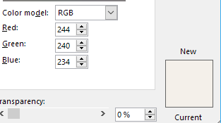

background colours!
WHAT DO YOU WISH TO COMPARE?
MY WISHLIST
<list is updated when user like/unlike>
Note: Click on the ? button to understand more..
USE DBS COLOURS
d
D
D
D
D
D
D
D
D
D
D
D
D
DD
DD
D
WE RECOMMEND:
DBS Black American Express® Card
Pop-up dialog, click Got it! to close
Recommended: DBS Altitude Visa Signature Card
Card Type
Undo
Redo
?
NEW!
DBS Altitude Visa Signature Card
Acceptance Rate
Remove
Annual Fee Waiver
?
?
Min Income(per annum)
?
Lifestyle Privilege
  Transport
  Dining
  Movies
  Travel
  Healthcare
DBS Woman's MasterCard® Card
?
Card Rewards & Benefits
  DBS Points
  Rebate/Cashback
  Miles
?
You are also eligible for:
DBS Altitude American Express ® Card
Card | Dining | Travel | Healthcare |  | ADD TO WISHLIST | CHOOSE ANOTHER CRITERIA BY CLICKING ABOVE
 | DBS Indulge Dining deals at over 1000 outlets islandwide American Express Selects Over 400 dining privileges islandwide | Special airline fares Complimentary hotel nights Up to 15% off car rentals | DBS Healthcare Privileges Special rates on health screening packages, specialist consultation fee and more.
 | DBS Indulge Dining deals at over 1000 outlets islandwide | Exclusive hotel and travel offers. Click here to learn more. | DBS Healthcare Privileges Special rates on health screening packages, specialist consultation fee and more.
 | DBS Indulge Dining deals at over 1000 outlets islandwide | Special airline fares Complimentary hotel nights Up to 15% off car rentals | DBS Healthcare Privileges Special rates on health screening packages, specialist consultation fee and more.
RANK
RESET
?
POSB Everyday Card
Recommended: DBS Black American Express® Card
DBS Black Visa Card
Similar users also applied for:
Remove
DBS Esso Card
Recommended: DBS Altitude Visa Signature Card
DBS Takashimaya Visa Card
DBS Live Fresh Card
Remove
Recommended: DBS Woman's MasterCard® Card
DBS Woman's World MasterCard® Card
Remove

Slide 15
Heuristic Inspection Feedback
Visbility:
Auto Hide List of cards
Fixed column for Apply at the right side of table
Too much info- 3 columns of card
COMBINE cards into 1 column
Expansion accordion menu
DO IN FLUID UI. USE SAME COLOUR SCHEMES AS DBS WEBSITE
Selected cards- overlay on image (not in a section on its own)
LIKE button only in comparson table
use checkbox, no need select all
wad u applied- last column bucket
RIGHT SIDE: APPLIED ; EXACT INFO FOR THE CARD
MORE INFO FOR THE CARD → link to website directly

Slide 16
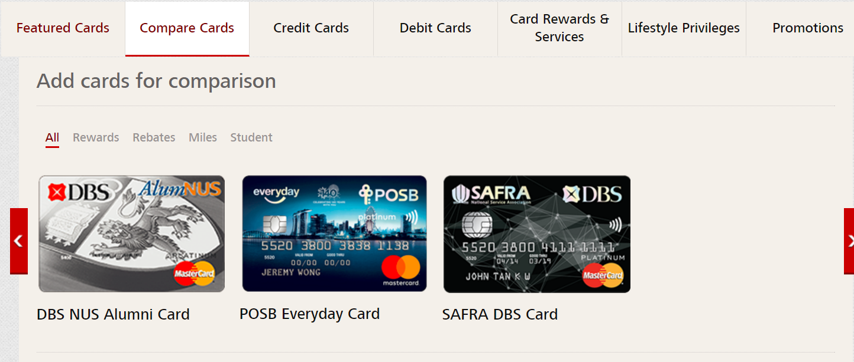

Slide 17
Revision Pt 1- Pre-selected Criterias

Slide 18
END

Slide 19
OLD VERSIONS

Slide 20
First Action- DIY Comparison Tool
Clicking a criteria, column appears
Cancel to remove it

Slide 21
HOW TO USE:
Tick on the criterias that you wish to compare. Click on Information button to understand more
i
DIY CARD COMPARER
SELECT ALL
CLEAR SELECTION
UNDO RESET
RECOMMENDED FOR YOU
Card Type
i
Your selection is currently empty.
Please select one or more criteria(s) from the left to compare.
Annual Fee Waiver
i
Min Income(per annum)
i
DBS Black American Express® Card
Card Rewards & Benefits
  DBS Points
  Rebate/Cashback
  Miles
i
DBS Altitude Visa Signature Card
Lifestyle Privilege
  Transport
  Dining
  Movies
  Travel
  Healthcare
i
DBS Woman's MasterCard® Card
i
RANK FOR ME

Slide 22
HOW TO USE:
Tick on the criterias that you wish to compare. Click on Information button to understand more
i
DIY CARD COMPARER
SELECT ALL
CLEAR SELECTION
RESET ALL
RECOMMENDED
FOR YOU
Card Type | DBS Points | Dining | Healthcare
American Express | 1X DBS Point on all transactions | DBS Indulge Dining deals at over 1000 outlets islandwide American Express Selects Over 400 dining privileges islandwide | DBS Healthcare Privileges Special rates on health screening packages, specialist consultation fee and more.
Visa | No expiry date for DBS Rewards Points | DBS Indulge Dining deals at over 1000 outlets islandwide
MasterCard | Earn 5X DBS Rewards Points on all online purchases | DBS Indulge Dining deals at over 1000 outlets islandwide
Card Type
i
Annual Fee Waiver
i
Min Income(per annum)
i
DBS Black American Express® Card
Card Rewards & Benefits
  DBS Points
  Rebate/Cashback
  Miles
i
DBS Altitude Visa Signature Card
Lifestyle Privilege
  Transport
  Dining
  Movies
  Travel
  Healthcare
i
DBS Woman's MasterCard® Card
i
RANK FOR ME

Slide 23
HOW TO USE:
Tick on the criterias that you wish to compare. Click on Information button to understand more
i
DIY CARD COMPARER
SELECT ALL
CLEAR SELECTION
RESET ALL
RECOMMENDED
FOR YOU
Card Type | Annual Fee Waiver | DBS Points | Dining | Healthcare
American Express | 1 Year | 1X DBS Point on all transactions | DBS Indulge Dining deals at over 1000 outlets islandwide American Express Selects Over 400 dining privileges islandwide | DBS Healthcare Privileges Special rates on health screening packages, specialist consultation fee and more.
Visa |  | No expiry date for DBS Rewards Points | DBS Indulge Dining deals at over 1000 outlets islandwide
MasterCard |  | Earn 5X DBS Rewards Points on all online purchases | DBS Indulge Dining deals at over 1000 outlets islandwide
Card Type
i
Annual Fee Waiver
i
Min Income(per annum)
i
DBS Black American Express® Card
Card Rewards & Benefits
  DBS Points
  Rebate/Cashback
  Miles
i
DBS Altitude Visa Signature Card
Lifestyle Privilege
  Transport
  Dining
  Movies
  Travel
  Healthcare
i
DBS Woman's MasterCard® Card
i
RANK FOR ME

Slide 24
Second Action- Ranking System
Click “Rank for me”, and we rank rankable criterias.

Slide 25
HOW TO USE:
Tick on the criterias that you wish to compare. Click on Information button to understand more
i
DIY CARD COMPARER
SELECT ALL
CLEAR SELECTION
RESET ALL
RECOMMENDED
FOR YOU
Card Type | DBS Points | Dining | Healthcare
American Express | 1X DBS Point on all transactions | DBS Indulge Dining deals at over 1000 outlets islandwide American Express Selects Over 400 dining privileges islandwide | DBS Healthcare Privileges Special rates on health screening packages, specialist consultation fee and more.
Visa | No expiry date for DBS Rewards Points | DBS Indulge Dining deals at over 1000 outlets islandwide
MasterCard | Earn 5X DBS Rewards Points on all online purchases | DBS Indulge Dining deals at over 1000 outlets islandwide
Card Type
i
Annual Fee Waiver
i
Min Income(per annum)
i
DBS Black American Express® Card
Card Rewards & Benefits
  DBS Points
  Rebate/Cashback
  Miles
i
DBS Altitude Visa Signature Card
Lifestyle Privilege
  Transport
  Dining
  Movies
  Travel
  Healthcare
i
DBS Woman's MasterCard® Card
i
RANK FOR ME

Slide 26
HOW TO USE:
Tick on the criterias that you wish to compare. Click on Information button to understand more
i
DIY CARD COMPARER
SELECT ALL
CLEAR SELECTION
RESET ALL
RECOMMENDED
FOR YOU
Card Type | DBS Points | Dining | Healthcare
American Express | 1X DBS Point on all transactions | 1 | SAME
Visa | No expiry date for DBS Rewards Points | 2
MasterCard | Earn 5X DBS Rewards Points on all online purchases | 2
Card Type
i
Annual Fee Waiver
i
Min Income(per annum)
i
DBS Black American Express® Card
Card Rewards & Benefits
  DBS Points
  Rebate/Cashback
  Miles
i
DBS Altitude Visa Signature Card
Lifestyle Privilege
  Transport
  Dining
  Movies
  Travel
  Healthcare
i
DBS Woman's MasterCard® Card
i
BACK

Slide 27
Third Action- Technical Info
Click on Information button, explanation will expand.

Slide 28
HOW TO USE:
Tick on the criterias that you wish to compare. Click on Information button to understand more
i
DIY CARD COMPARER
SELECT ALL
CLEAR SELECTION
RESET ALL
RECOMMENDED
FOR YOU
Card Type | DBS Points | Dining | Healthcare
American Express | 1X DBS Point on all transactions | DBS Indulge Dining deals at over 1000 outlets islandwide American Express Selects Over 400 dining privileges islandwide | DBS Healthcare Privileges Special rates on health screening packages, specialist consultation fee and more.
Visa | No expiry date for DBS Rewards Points | DBS Indulge Dining deals at over 1000 outlets islandwide
MasterCard | Earn 5X DBS Rewards Points on all online purchases | DBS Indulge Dining deals at over 1000 outlets islandwide
Card Type
i
Annual Fee Waiver
i
Min Income(per annum)
i
DBS Black American Express® Card
Card Rewards & Benefits
  DBS Points
  Rebate/Cashback
  Miles
i
DBS Altitude Visa Signature Card
Lifestyle Privilege
  Transport
  Dining
  Movies
  Travel
  Healthcare
i
DBS Woman's MasterCard® Card
i
RANK FOR ME

Slide 29
HOW TO USE:
Tick on the criterias that you wish to compare. Click on Information button to understand more
i
DIY CARD COMPARER
SELECT ALL
CLEAR SELECTION
RESET ALL
RECOMMENDED
FOR YOU
Card Type | DBS Points | Dining | Healthcare
American Express | 1X DBS Point on all transactions | DBS Indulge Dining deals at over 1000 outlets islandwide American Express Selects Over 400 dining privileges islandwide | DBS Healthcare Privileges Special rates on health screening packages, specialist consultation fee and more.
Visa | No expiry date for DBS Rewards Points | DBS Indulge Dining deals at over 1000 outlets islandwide
MasterCard | Earn 5X DBS Rewards Points on all online purchases | DBS Indulge Dining deals at over 1000 outlets islandwide
Card type
Card type refers to the credit card companies that process payments. The cards themselves are issued by DBS only.
-
Annual Fee Waiver
i
DBS Black American Express® Card
Min Income(per annum)
i
Card Rewards & Benefits
  DBS Points
  Rebate/Cashback
  Miles
i
DBS Altitude Visa Signature Card
Lifestyle Privilege
  Transport
  Dining
  Movies
  Travel
  Healthcare
i
DBS Woman's MasterCard® Card
i
RANK FOR ME

Slide 30
Fourth Action- Reset All
Click on reset all to clear selection.
User will be prompted to select criterias to compares
Forgiveness- User can undo Reset.

Slide 31
HOW TO USE:
Tick on the criterias that you wish to compare. Click on Information button to understand more
i
DIY CARD COMPARER
SELECT ALL
CLEAR SELECTION
RESET ALL
RECOMMENDED FOR YOU
Card Type | DBS Points | Dining | Healthcare
American Express | 1X DBS Point on all transactions | DBS Indulge Dining deals at over 1000 outlets islandwide American Express Selects Over 400 dining privileges islandwide | DBS Healthcare Privileges Special rates on health screening packages, specialist consultation fee and more.
Visa | No expiry date for DBS Rewards Points | DBS Indulge Dining deals at over 1000 outlets islandwide | DBS Healthcare Privileges Special rates on health screening packages, specialist consultation fee and more.
MasterCard | Earn 5X DBS Rewards Points on all online purchases | DBS Indulge Dining deals at over 1000 outlets islandwide | DBS Healthcare Privileges Special rates on health screening packages, specialist consultation fee and more.
Card Type
i
Annual Fee Waiver
i
Min Income(per annum)
i
DBS Black American Express® Card
Card Rewards & Benefits
  DBS Points
  Rebate/Cashback
  Miles
i
DBS Altitude Visa Signature Card
Lifestyle Privilege
  Transport
  Dining
  Movies
  Travel
  Healthcare
i
DBS Woman's MasterCard® Card
i
RANK FOR ME

Slide 32
HOW TO USE:
Tick on the criterias that you wish to compare. Click on Information button to understand more
i
DIY CARD COMPARER
SELECT ALL
CLEAR SELECTION
UNDO RESET
RECOMMENDED FOR YOU
Card Type
i
Your selection is currently empty.
Please select one or more criteria(s) from the left to compare.
Annual Fee Waiver
i
Min Income(per annum)
i
DBS Black American Express® Card
Card Rewards & Benefits
  DBS Points
  Rebate/Cashback
  Miles
i
DBS Altitude Visa Signature Card
Lifestyle Privilege
  Transport
  Dining
  Movies
  Travel
  Healthcare
i
DBS Woman's MasterCard® Card
i
RANK FOR ME

